Slide 1



Slide 2
pLED 2014
Ha Noi, April 26th

Slide 3
Introduction Team
pLED Team
1
Nguyễn Thanh Tùng : PM, Designer, Tester
2
Nguyễn Thế Long: Technical Leader, Developer
Đỗ Văn Ban: Mechanic, Tester
Đinh Xuân Bách: QA, Test Leader
Đinh Quang Hải: Developer, Designer

Slide 4
Contents
1
1
Introduction
5
Implementation
2
2
6
Testing and Quality Assurance
Management Plan
3
Requirement
Specifications
7
Demo
4
Conclusion and Q&A
Design
8

Slide 5
Introduction
Persistent of Vision : The phenomenon of the eye by which an after-image is thought to persist for approximately one twenty-fifth of a second on the retina, create a illusion of existing object when there was none.

Slide 6
Introduction
Idea Base on Persistence of Vision phenomenon, we have made a device that can create a clock, a picture, a animation screen in front of audiences.

Slide 7
Introduction
Scope
System will:
Display 4 modes
Remote control using radio frequency
Display Real – Time Clock (GMT + 7)
Store data and require one-time setup only

Slide 8
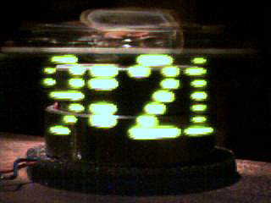
Introduction
Existed product : “Bob Blick‘s propeller clock”

Slide 9
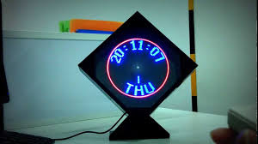
Introduction
Existed product : “AVClock”

Slide 10
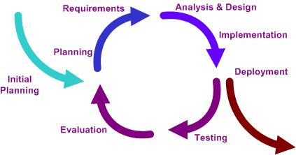
Management Plan
Software Process Model: Iterative and Increment Development (IID)

Slide 11
Management Plan
Delivery : 17/4/2014
Efforts : 5 mem/month
Duration : 3 months
Budget: 92 million VND ☺

Slide 12
Management Plan
Risk Management
No experiences design hardware
Uncontrollable outsourcing
Limited physical components
Less experiences estimate time and resource

Slide 13
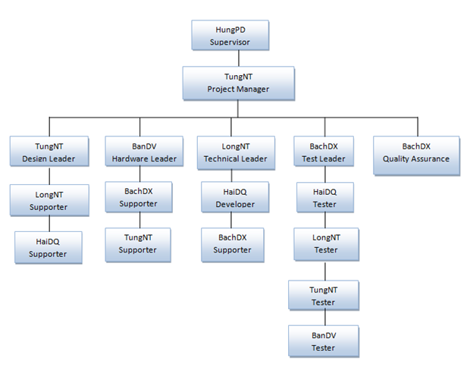
Management Plan
Role and Responsibilities

Slide 14
Management Plan
Configuration Management
Using google code : https://pled.googlecode.com/svn/
Document and file must be save on right folder SVN
Version of document must be increase if it was changed
When commit file and document into SVN member must be write comment or message

Slide 15
Requirement Specifications
User Requirements
User
Real – Time Clock
Decorating
Student
System demo when learn Embedded System

Slide 16
Requirement Specifications
System Specification
Using Microcontroller
Multicolor image, clock
Remote control
One-time setup
Real-time clock built-in
Electrical standard (220v AC)

Slide 17
Requirement Specifications
Functional
Display digital clock
Display analog clock
Display image
Display text
Setup time

Slide 18
Requirement Specifications
Non - Functional
System stable
Picture display smoothly
Usability
Safety

Slide 19
Requirement Specifications
Infrastructure and Tools
Hardware
PIC16F887
DS1307
EEPROM
LED RGB
Radio Frequency Module
Shift Register
IC 7805
Motor

Slide 20
Requirement Specifications
Infrastructure and Tools
Software
ISIS Proteus
Altium Designer 10
IDE CCS C 5.015
Pickit 2 programmer
Visual Studio 2012 and .NET 4.0
Electronic multi-meter

Slide 21
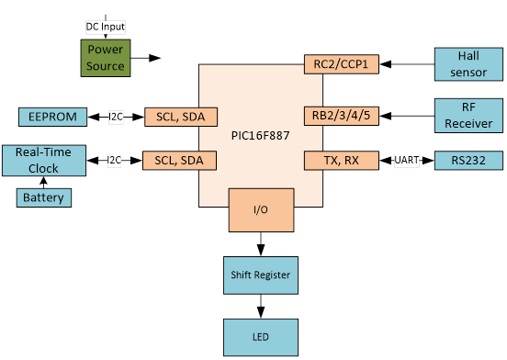
Design
Architecture Design
Block Diagram

Slide 22
Design
Mechanical
Include: rotation + supply power

Slide 23
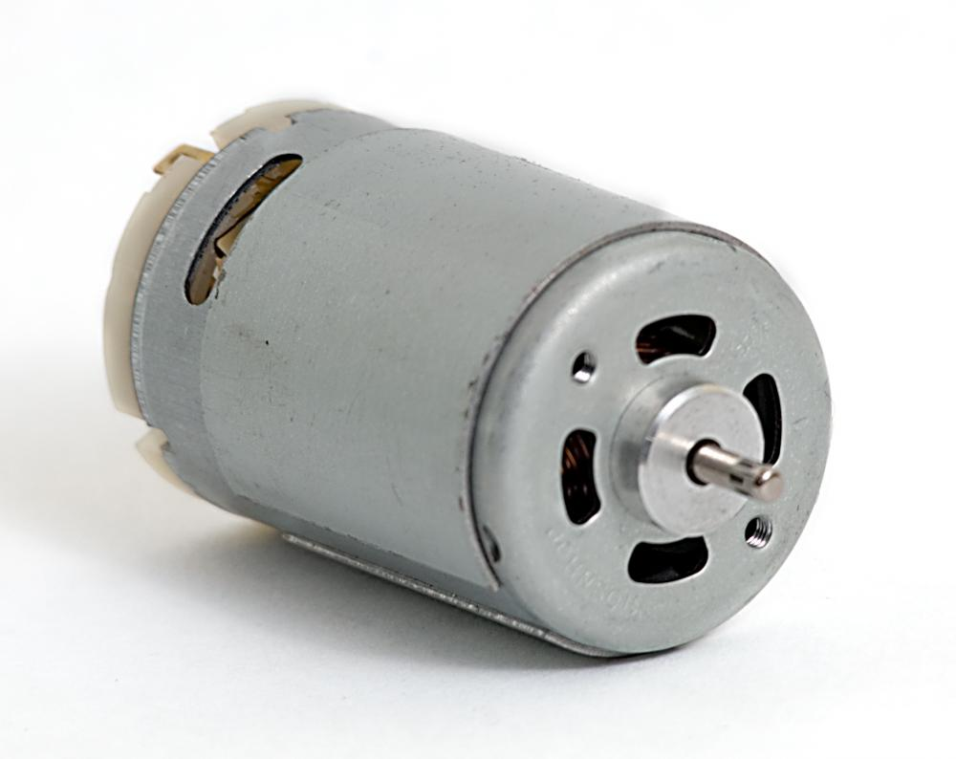
DC MOTOR
Rotation
Speed: 1800rpm(1200-2000rpm)
Supply power: 5V-2A

Slide 24
Design
Mechanical
VCC
VCC
Motor
Bearing
Shaft
GND
Plastic

Slide 25
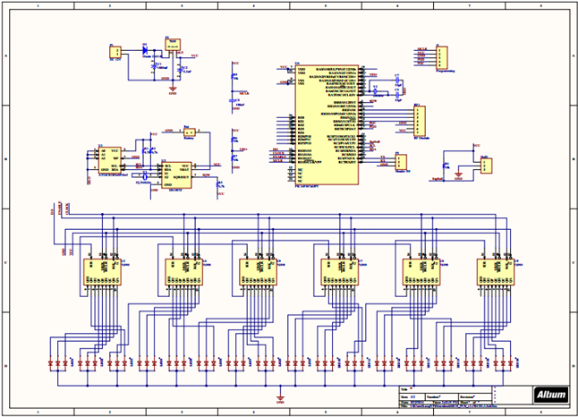
Design
Schematic, PCB Design

Slide 26
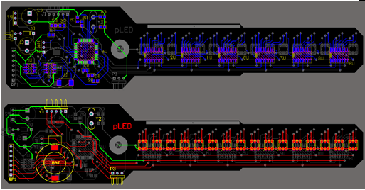
Design
Printed Circuit Design

Slide 27
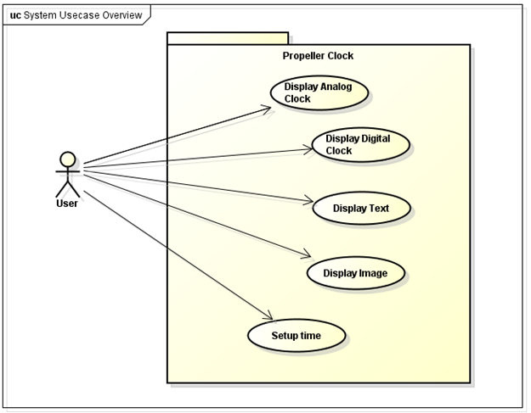
Design
Architecture Design
Use case

Slide 28
Design
Display Mode
MODE_A: Analog Clock
MODE_B: Digital Clock
MODE_C: Still image
MODE_D: Running text

Slide 29
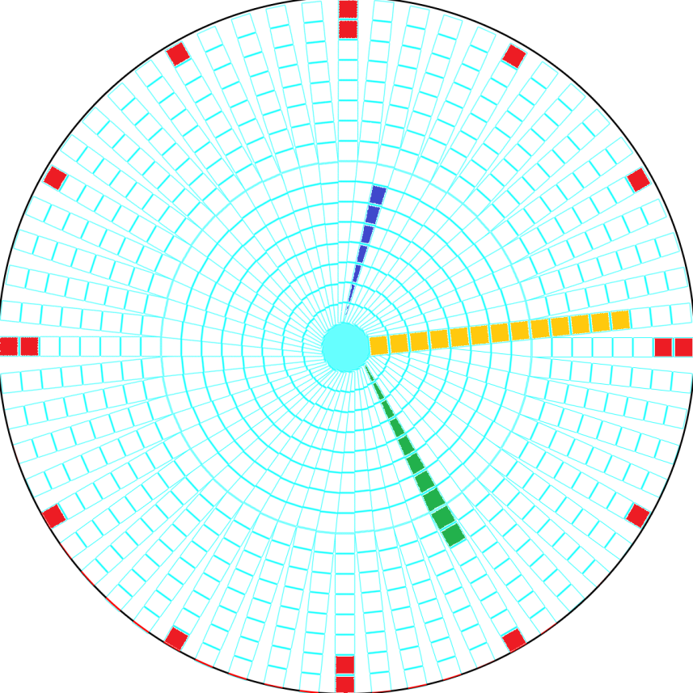
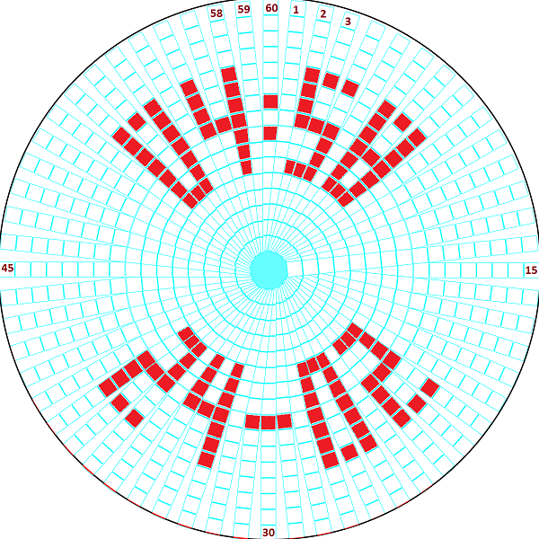
Design
Screen 16 LEDs x 60 NODEs

Slide 30
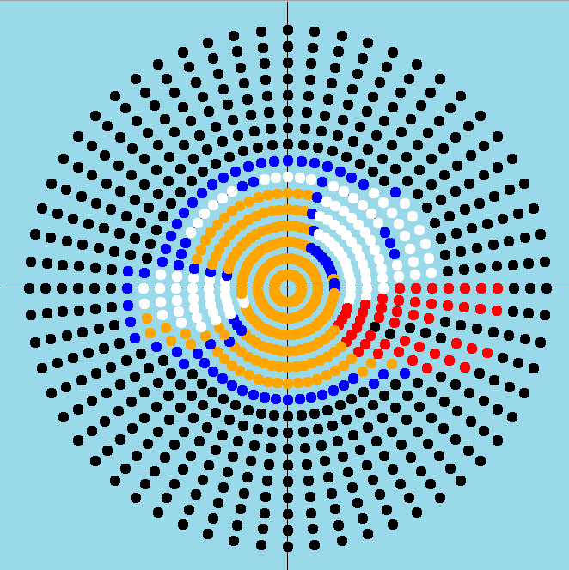
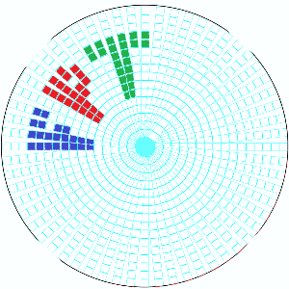

Slide 31
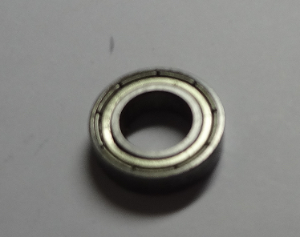
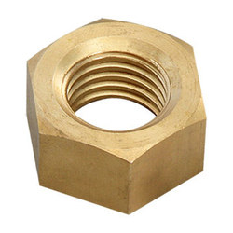
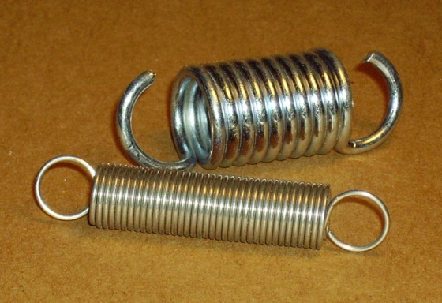
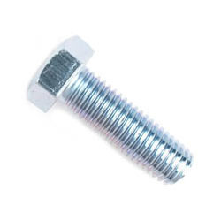
Implementation
Mechanical
Nut and bolt
Rolling-element bearing
Motor
Spring

Slide 32
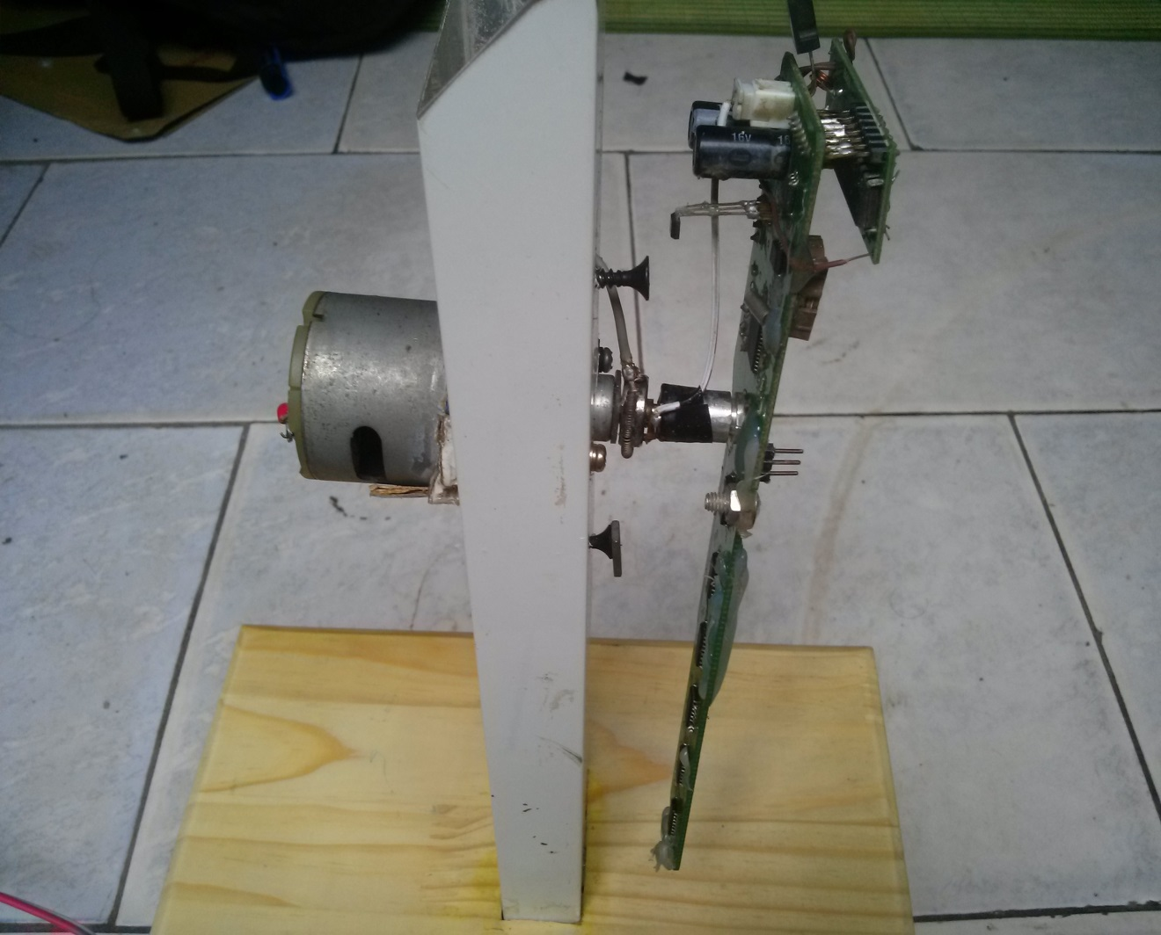
Implementation
Mechanical

Slide 33
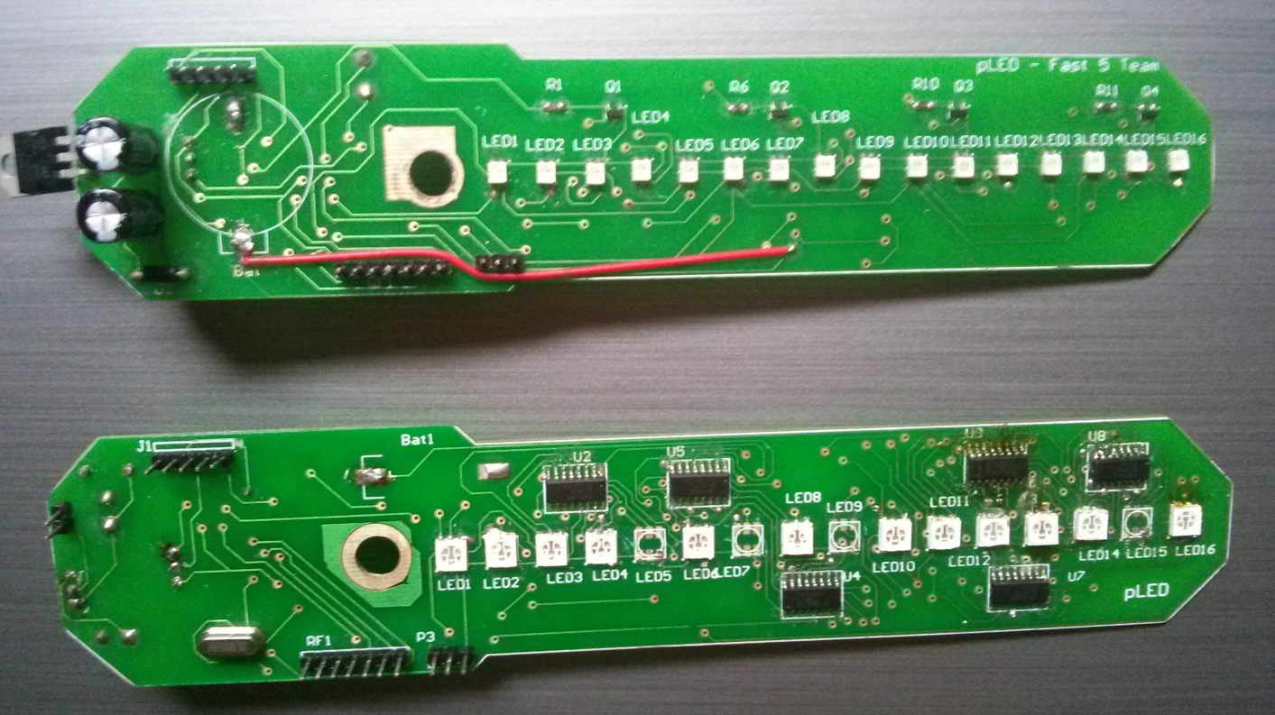
Implementation
Circuit Board
pLed dual and triple color v1.0 (legacy)

Slide 34
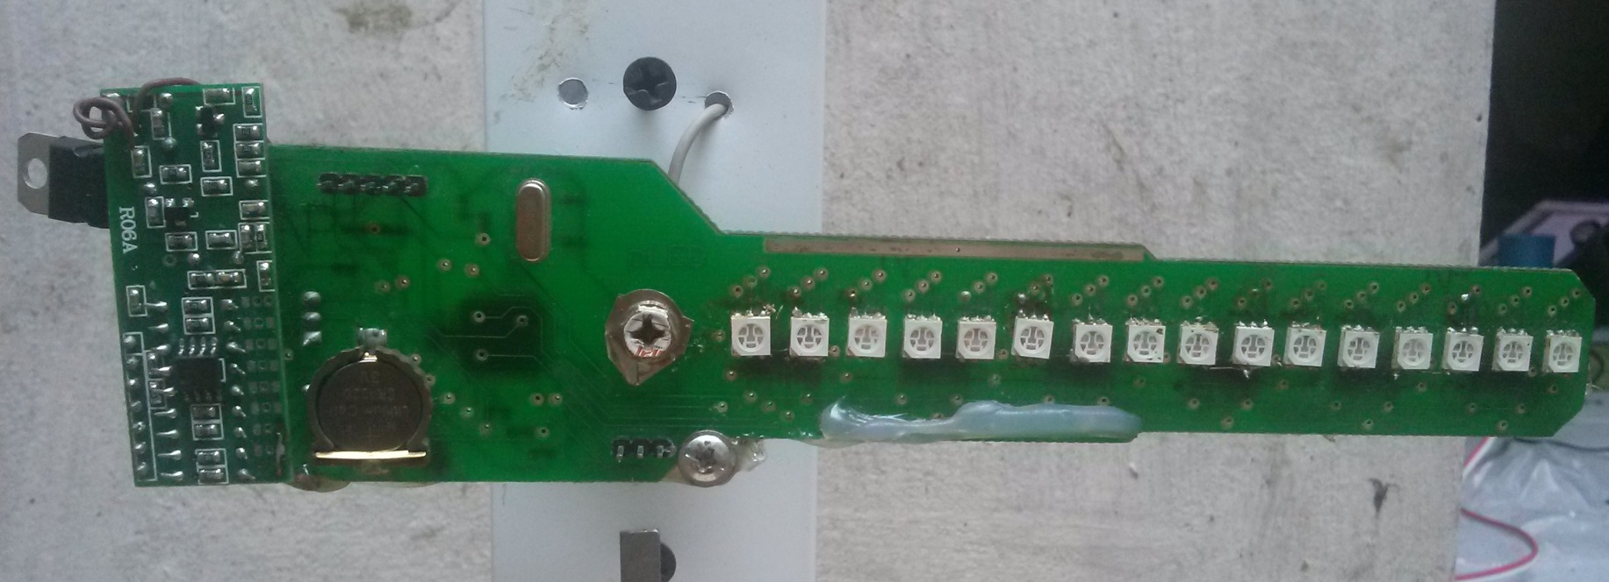
Implementation
Circuit Board
pLed triple color v2.0

Slide 35
Implementation
LED’s data structure INT16[3]
 | BYTE 1 |  |  |  |  |  |  |  | BYTE 0
 | 7 | 6 | 5 | 4 | 3 | 2 | 1 | 0 | 7 | 6 | 5 | 4 | 3 | 2 | 1 | 0
 | LED1 | LED2 | LED3 | LED4 | LED5 | LED6 | LED7 | LED8 | LED9 | LED10 | LED11 | LED12 | LED13 | LED14 | LED15 | LED16
rgb_bits.blue
rgb_bits.red
rgb_bits.green

Slide 36
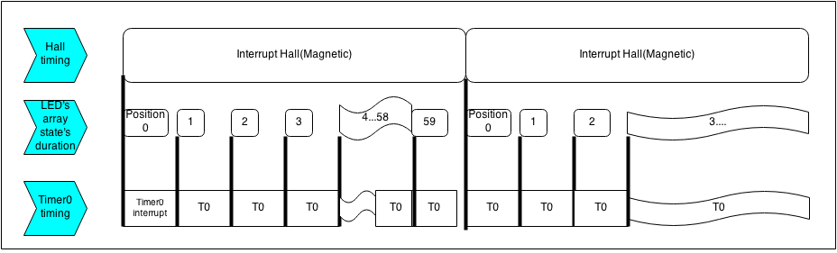
Implementation
Timing algorithm
The system use 2 interrupts to acknowledge when a new rotation started and when to print out the next Position’s data of LEDs array.
Each Hall interruption indicates when the array LED has finished a rotation.

Slide 37
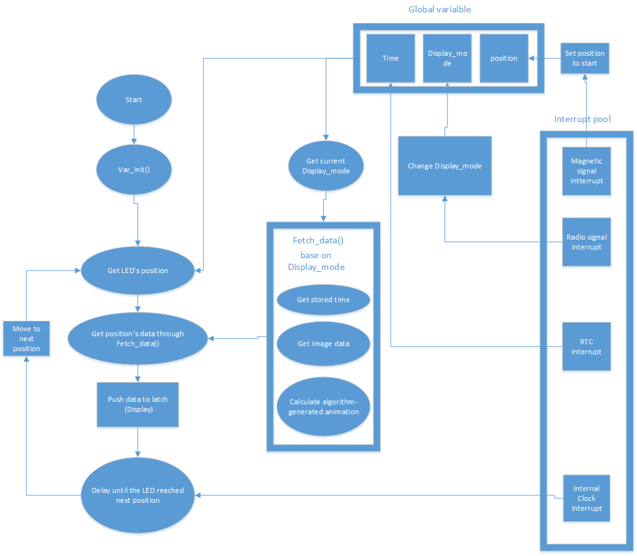
Implementation
System structure

Slide 38
Implementation
Fetch_data() ➔ rgb_bits
Mode
Node Position
Time
Image data
State variables

Slide 39
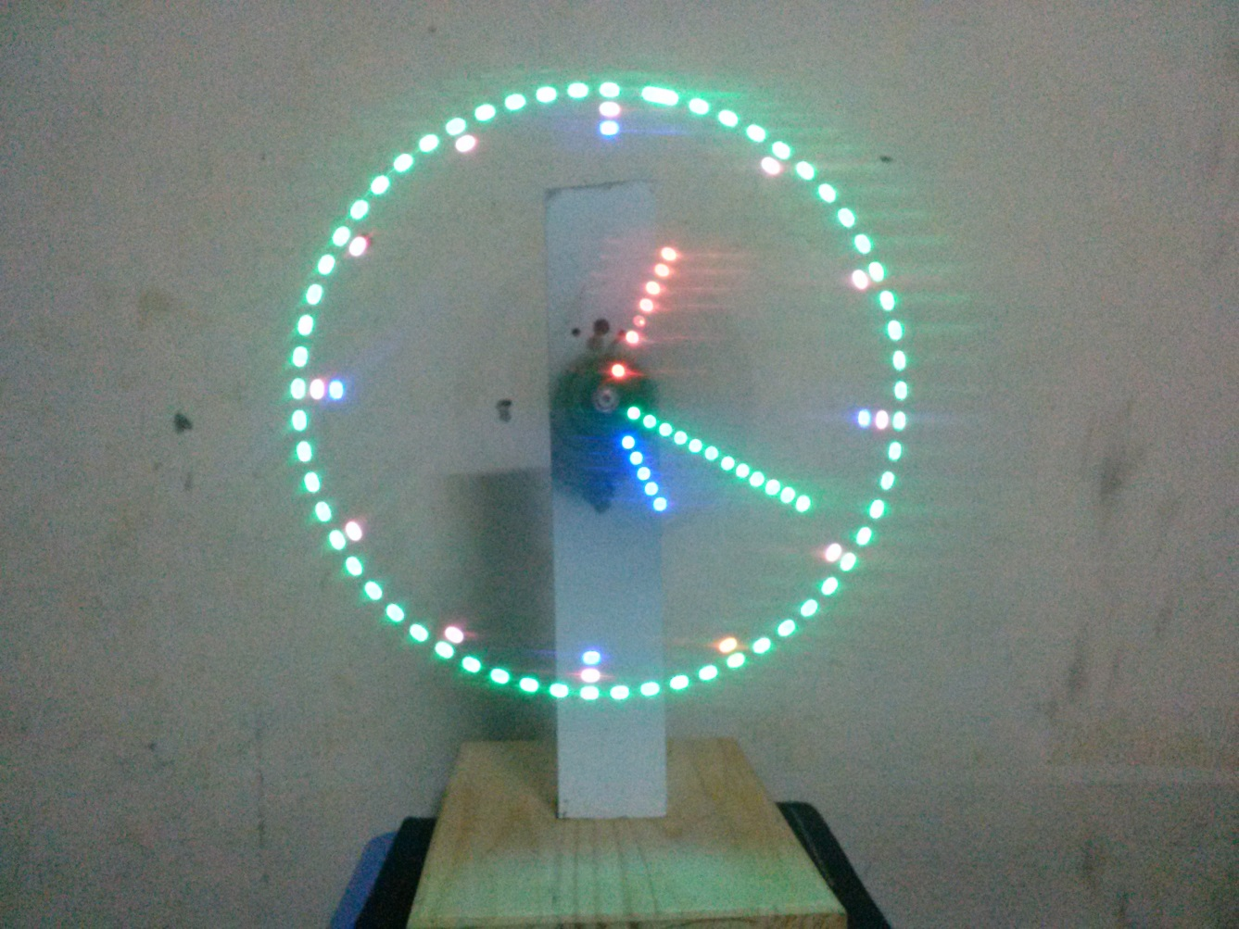
Implementation
Analog Clock

Slide 40
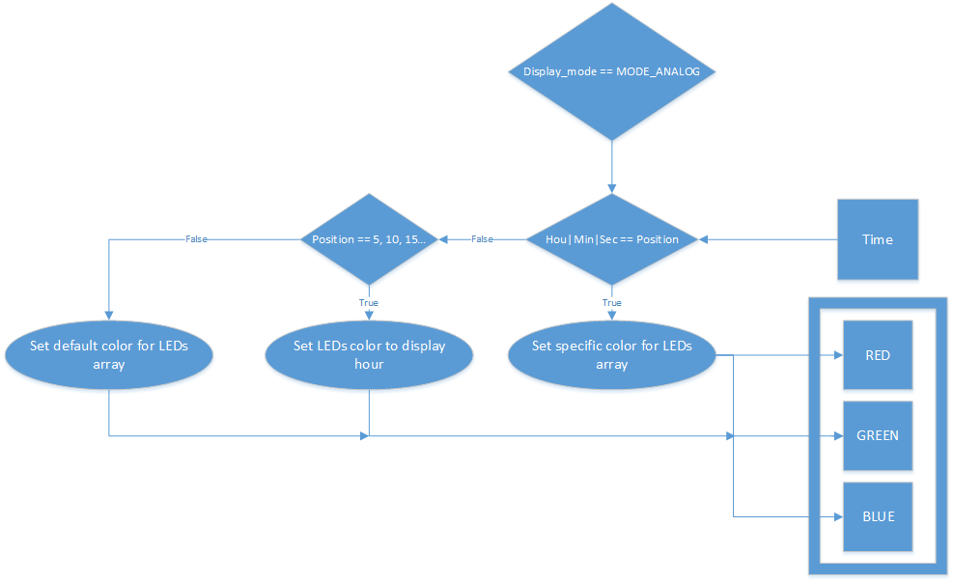
Clock Mode

Slide 41
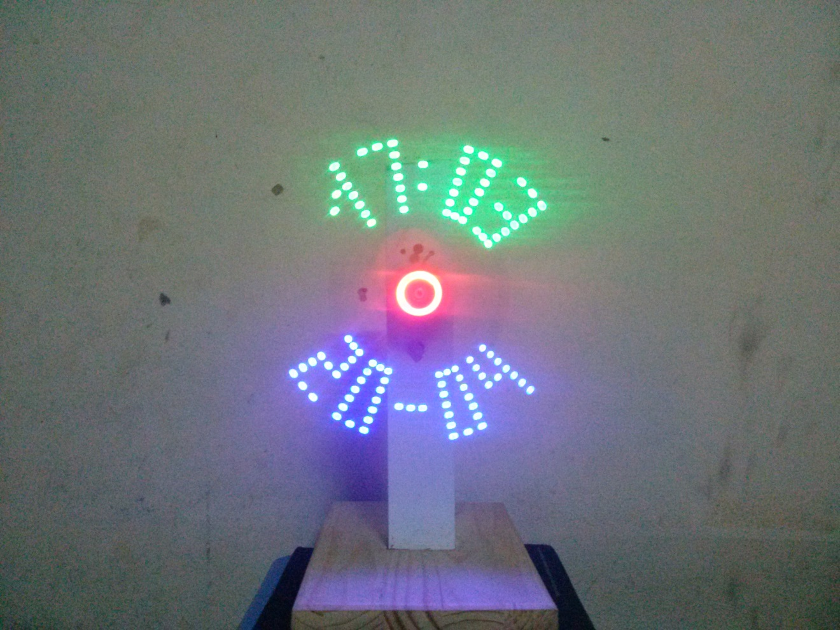
Implementation
Digital Clock

Slide 42
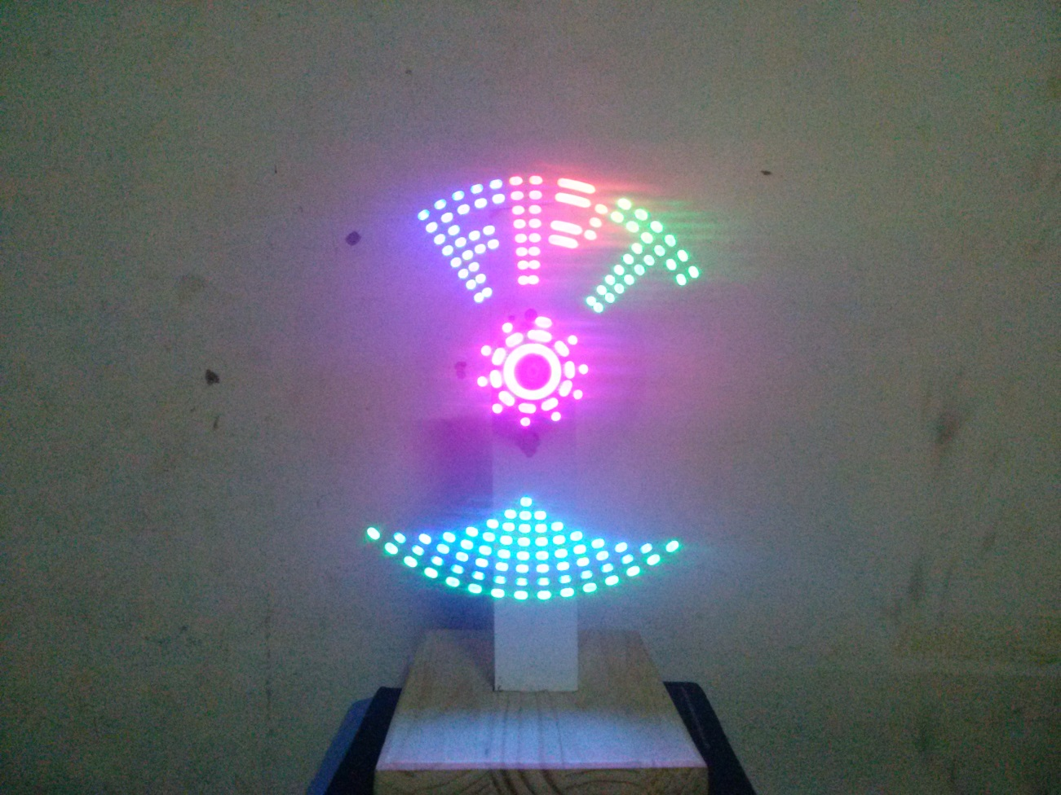
Implementation
Image

Slide 43
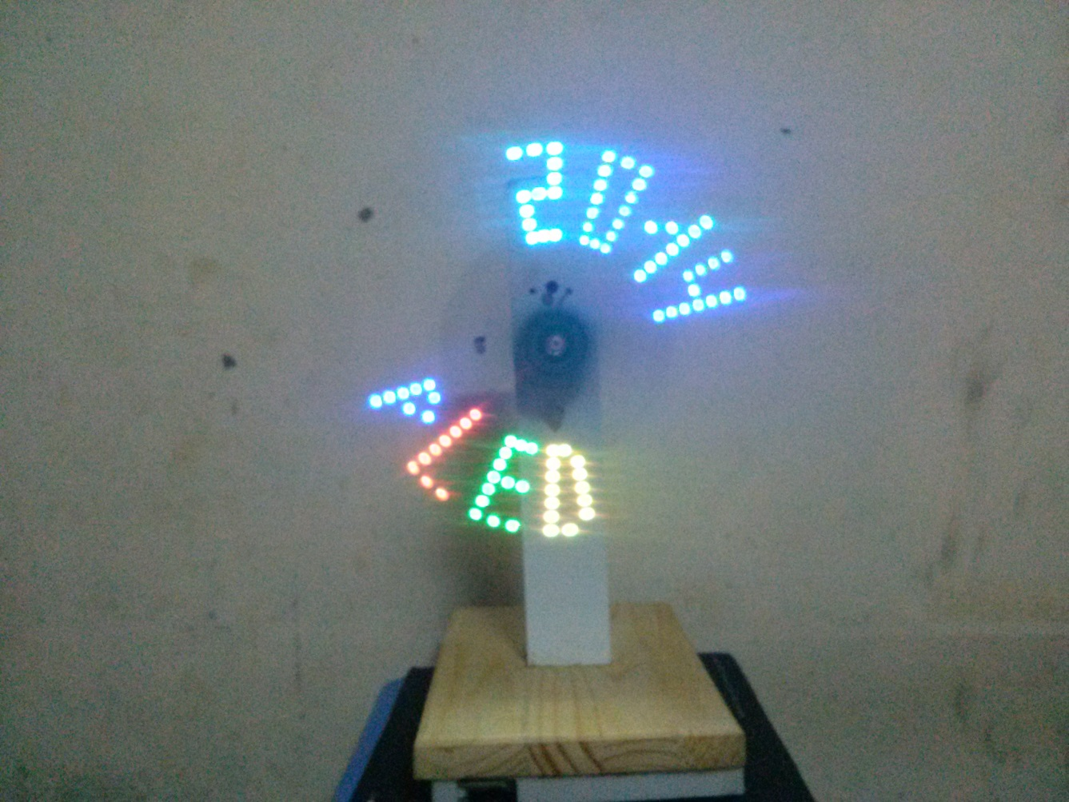
Implementation
Text

Slide 44
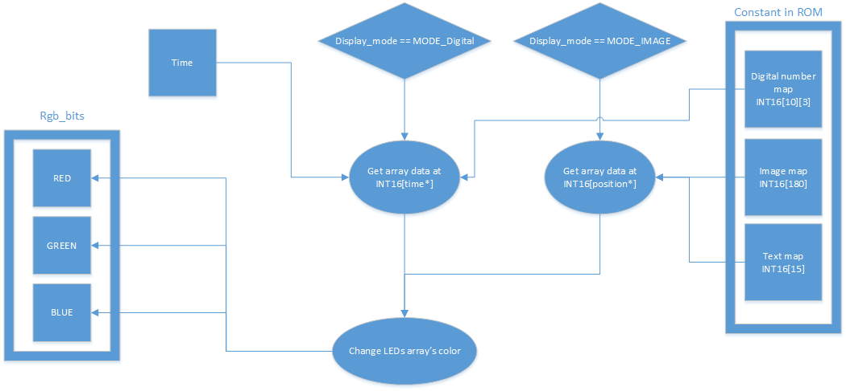
Image & Text Mode

Slide 45
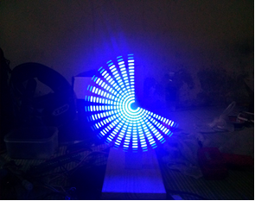
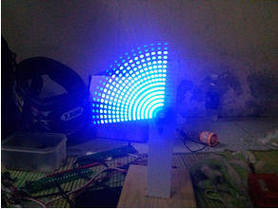
Implementation
Modify Driver: performance
Before optimization
40 state changes take 7/10 rotation
After Optimization
40 state changes take 3/10 rotation

Slide 46
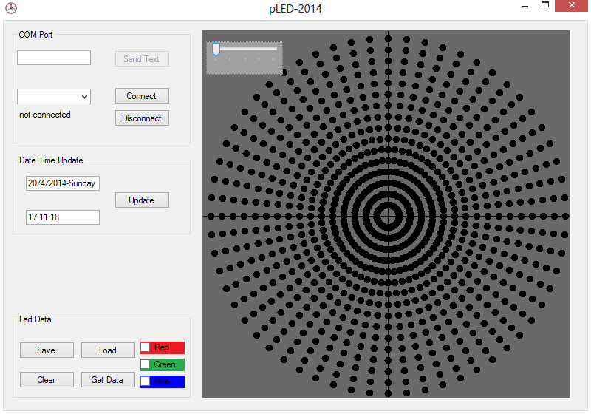
Implementation
Setup Time

Slide 47
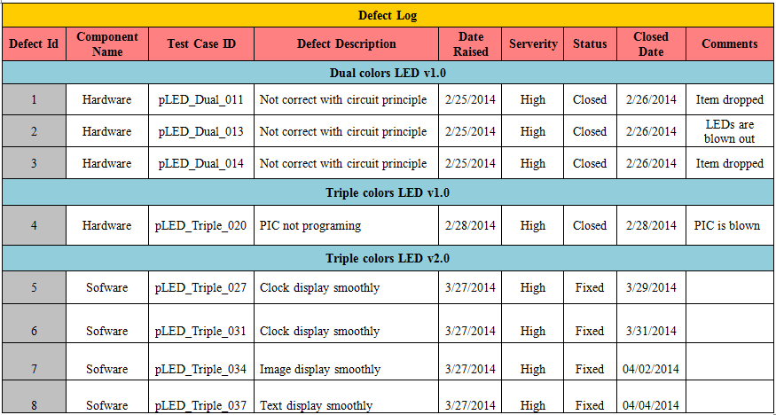
Testing &QA
Defect Log

Slide 48
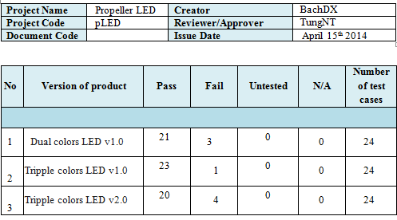
Testing &QA
Test Report

Slide 49
Testing &QA
Quality Assurance
4 bugs after release
4 bugs into 1 issue

Slide 50
Lesson learnt
Obstacles
Solution
Limited hardware option
Processing power is a lot lower than expected
Soldering quality is low
Inexperienced in estimate time schedule
Re-inspect the market and buy extra amount if possible
Optimize driver and using multiple backup algorithms
Manually checking circuit board’s completion and self-learn soldering
Asking for supervisor suggestion

Slide 51
Suggested improvement
Using higher performance controller, 16bits chip is recommended
Develop team’s own soldering staff for easier maintain and customization
Use popular components for easier acquire, replacing ,and better community’s support.
Frequently asking for professional opinion to avoid rookie mistakes.

Slide 52
Thank You !

Slide 53
Question and Answer

